Slide 1
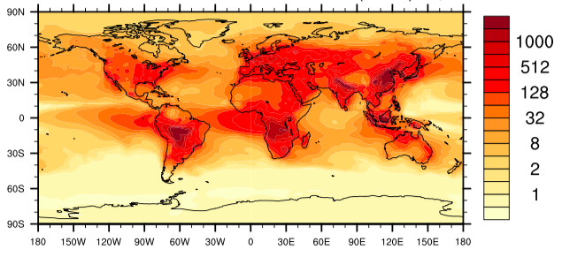
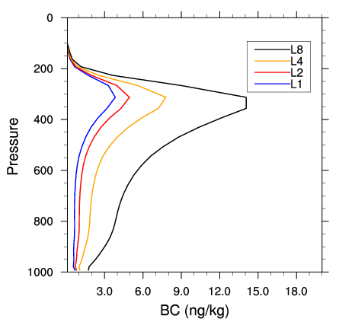
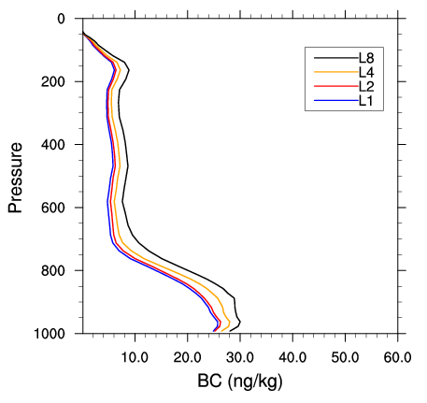
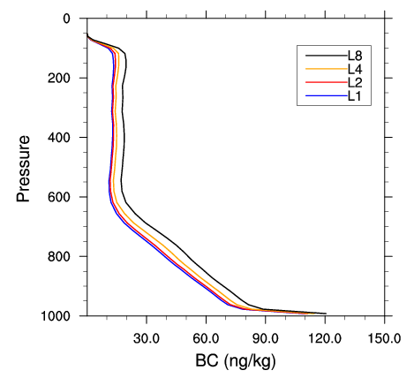
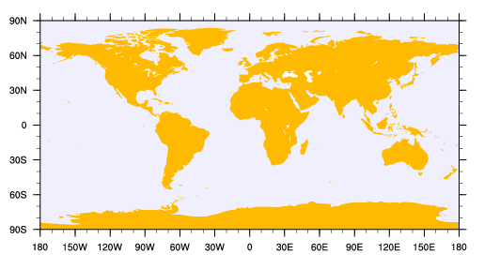
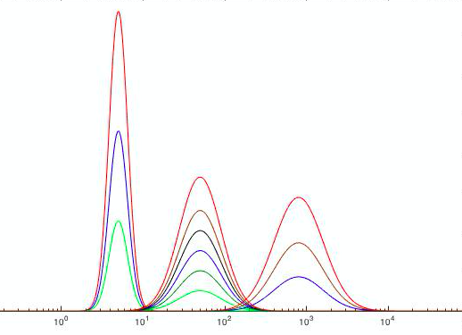
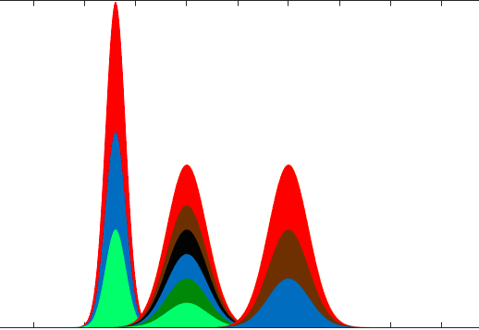
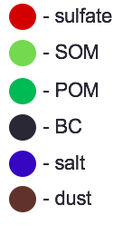
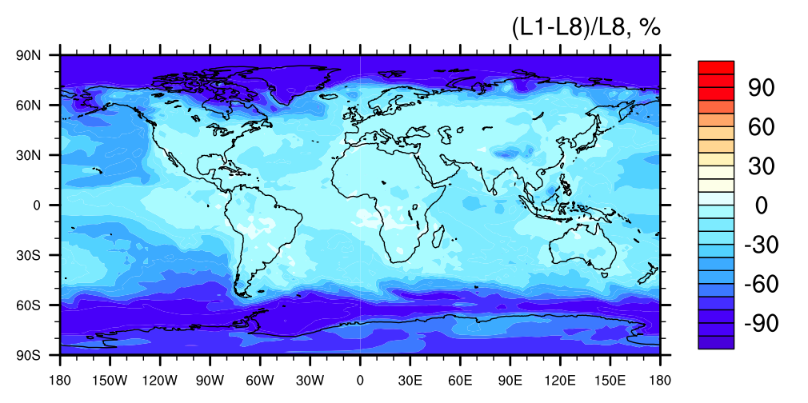
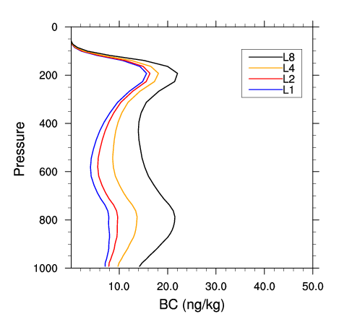
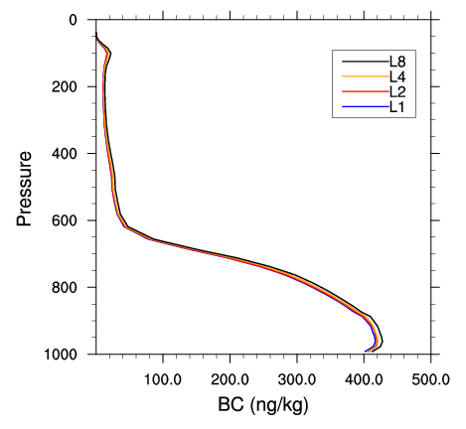
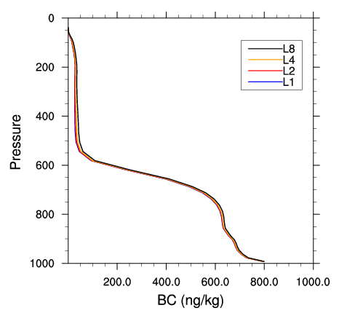
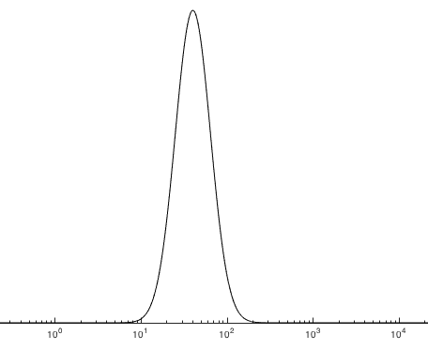
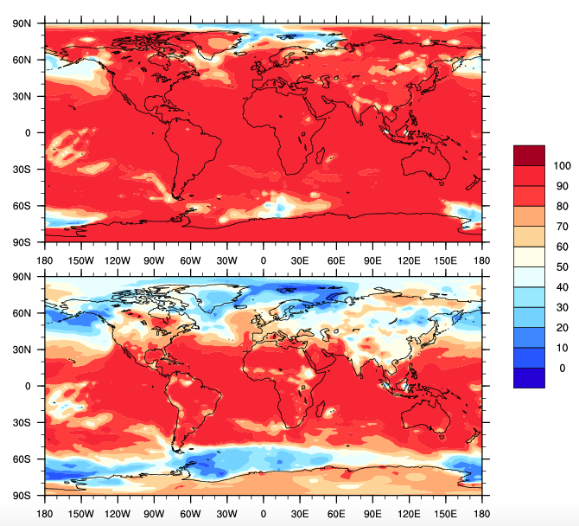
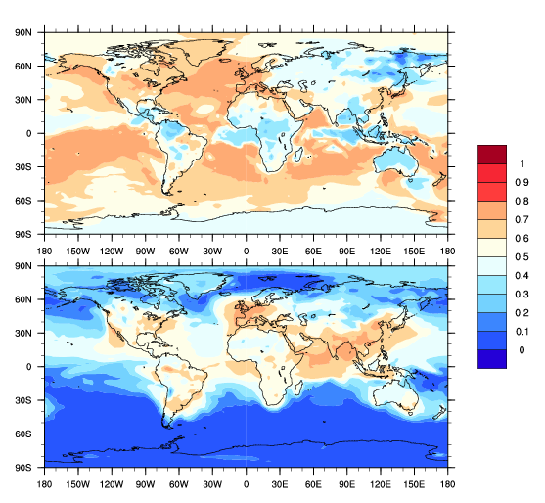
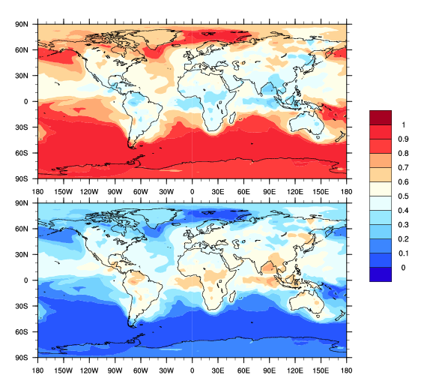
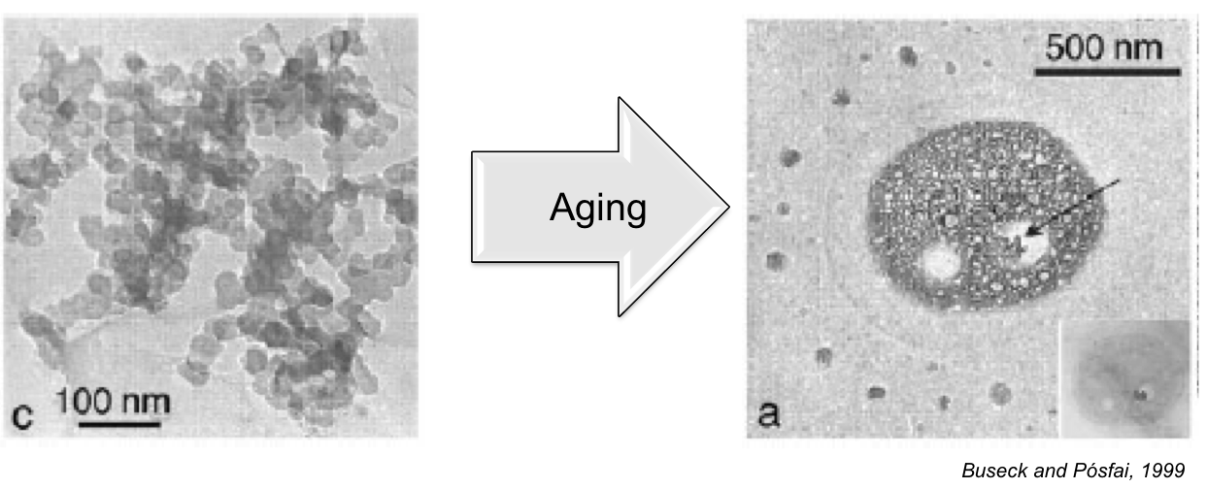
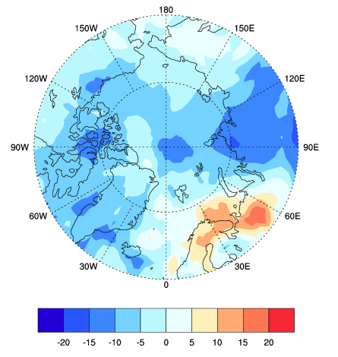
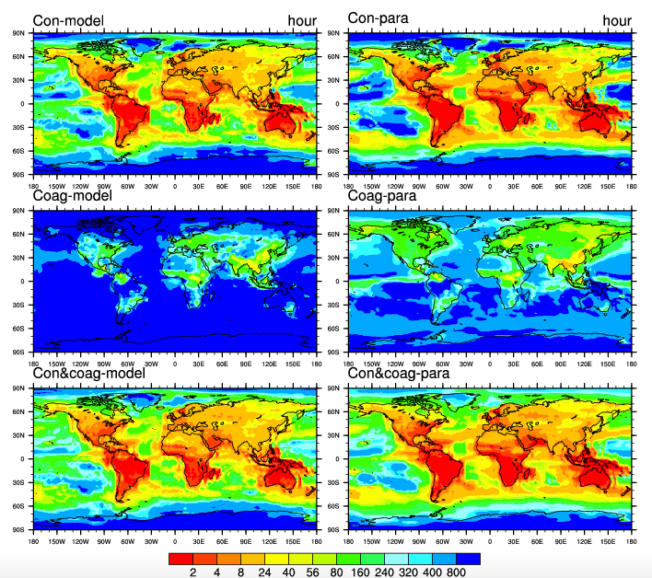
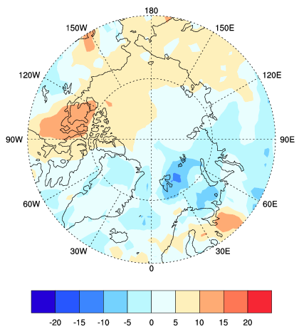

Analysis of BC Aging with CAMChem Model
Yinrui Li, Nicole Riemer, Laura Fierce, …?? Donald Wuebbles Department of Atmospheric Science, The School of Earth, Society & Environment , College of Liberal Arts and Sciences, University of Illinois at Urbana-Champaign
Introduction
Black carbon (BC) strongly absorbs visible light, though with large uncertainties (Bond et al., 2013). To better understand its climate effect requires us to develop faithful representation of the evolution of aerosol properties such as aerosol optical properties and cloud condensation nuclei activities in global climate models, which largely depend on micro-scale processes.
One key process is called the ‘aging’ of BC, conversion of fresh, hydrophobic black carbon into aged, hydrophilic black carbon, directly contributing to CCN activation and wet removal. Currently, failure to understand and to capture BC aging is the key factor that contributes to the uncertainties of BC burden and climate effect in global models. BC particles are usually characterized with an arbitrary aging timescale (1-2 days) or with mechanistic transfer rates from fresh to aged type, both are very sensitive to the choices of assumed parameters.
Meanwhile, particle-resolved aerosol model (PartMC-MOSAIC) has introduced a more precise way to estimate BC aging timescales by tracing the size and composition of individual particles, without making a priori assumptions (Riemer et al., 2010). Our previous study has found parameterization of BC’s aging by doing hundreds of particle-resolved simulations and linear regression, which can be applied to the output of global models to assess the accuracy of its aging criterion.
Method
MAM4 and Aging Scheme in CAMChem
Results
Sensitivity Analysis on Number of Monolayers
Comparing BC Mixing State from CAMChem to SP2 Measurements. (March for example, 992hPa)
Process Analysis of BC Aging
4-mode Modal Aerosol Model (MAM4) in CAMChem
Monthly BC Mass Mixing Ratio (L8, 992hPa)
Monthly BC Vertical Profile
1
March
2
3
Relative Difference (L1-L8)/L8, 992hPa
ng/kg
1
2
3
September
L1: 1 monolayer
L2: 2 monolayers
L4: 4 monolayers
L8: 8 monolayers
L12: 12 monolayers
10⁰ 10¹ 10² 10³ 10⁴
Aitken Accumulation Coarse
Coagulation
Condensation
%
1
2
3
10⁰ 10¹ 10² 10³ 10⁴
BC Ratio in CAMChem
(BC in Accumulation Mode/Total BC)
Primary Carbon
BC Volume Fraction within SP2 Size Range (90 - 400nm)
Mixing State of BC Observed by SP2
BC aging timescale computed from model transfer rate due to Coagulation and Condensation processes (aging).
In the Arctic:
Most of BC detected by SP2 measurements is externally mixed.
L1
Primary Carbon Mode
Primary Carbon Mode
Geometric standard deviations and dry diameter range. (Liu et al., 2012).
SP2 can capture most of BC in accumulation mode (internally mixed) when it is close to source regions.
MAM4 | σ_{g} | Size range (μm)
Aitken | 1.6 | 0.015-0.053
Accumulation | 1.8 | 0.058-0.27
Primary carbon | 1.6 | 0.039-0.13
Coarse | 1.8 | 0.80-3.65
L8
%
Accumulation Mode
Accumulation Mode
In the Arctic: Most of BC is in primary carbon mode (externally mixed)!
L1
L2
Abstruct
In this study, we assessed the treatment of aerosols in the global CAMChem model. We did sensitivity analysis on the its aging criterion to BC burden and radiative forcing. We also did process analysis on BC aging timescales by applying PartMC-MOSAIC parameterization to the model output, and compared this timescales with the e-folding time of BC conversion in CAMChem model. For future comparison with SP2 measurement, we computed the volume fraction and mixing states of BC that can be captured by SP2 measurements.
We observe:
Simulated BC vertical profiles and direct radiative forcing in the Arctic are very sensitive to choices of aging criterion.
Aging timescales range from less than one hour to several days.
Condensation of SOA and sulfate plays a dominating role in BC aging.
MAM4 aging timescales are broadly consistent with PartMC MOSAIC aging timescales.
BC observed by SP2 in the Arctic are mostly externally mixed (>80%).
Comparison of Aging Timescales
Condensation: “Monolayer-of-sulfate criterion”
CAMChem
PartMC
The equivalent of 8-monolayers of sulfate is needed to transfer material from the primary carbon mode (fresh) into the accumulation mode (aged).
L4
L8
BC core
8 monolayers of sulfate
Timescale of BC aging based on PartMC-MOSAIC simulations (Fierce et al., BAMS 2016):
I_{cond}: total volume condensation rate over surface area.
N: total aerosol number concentration.
CAMChem:
monolayer depth = molecule diameter
References
condensation coagulation
condensation coagulation
CONCLUSIONS

Slide 2
Analysis of BC Aging with CAMChem Model
Yinrui Li, Nicole Riemer, Laura Fierce, …?? Donald Wuebbles Department of Atmospheric Science, The School of Earth, Society & Environment , College of Liberal Arts and Sciences, University of Illinois at Urbana-Champaign
Introduction
Black carbon (BC) strongly absorbs visible light, though with large uncertainties (Bond et al., 2013). To better understand its climate effect requires us to develop faithful representation of the evolution of aerosol properties such as aerosol optical properties and cloud condensation nuclei activities in global climate models, which largely depend on micro-scale processes.
One key process is called the ‘aging’ of BC, conversion of fresh, hydrophobic black carbon into aged, hydrophilic black carbon, directly contributing to CCN activation and wet removal. Currently, failure to understand and to capture BC aging is the key factor that contributes to the uncertainties of BC burden and climate effect in global models. BC particles are usually characterized with an arbitrary aging timescale (1-2 days) or with mechanistic transfer rates from fresh to aged type, both are very sensitive to the choices of assumed parameters.
Meanwhile, particle-resolved aerosol model (PartMC-MOSAIC) has introduced a more precise way to estimate BC aging timescales by tracing the size and composition of individual particles, without making a priori assumptions (Riemer et al., 2010). Our previous study has found parameterization of BC’s aging by doing hundreds of particle-resolved simulations and linear regression, which can be applied to the output of global models to assess the accuracy of its aging criterion.
Method
MAM4 and Aging Scheme in CAMChem
Condensation: “Monolayer-of-sulfate criterion
Timescales of BC aging based on PartMC-MOSAIC simulations (Fierce et al., BAMS 2016):
Results
Sensitivity Analysis on Number of Monolayers
2. Sensitivity Analysis on Number of Monolayers
3. Comparing BC Mixing State from CAMChem to SP2 Measurements. (March for example, 992hPa)
L1
L2
Condensation plays a dominating role.
Aging timescales range from less than one hour to several days.
MAM4 aging timescales are broadly consistent with PartMC MOSAIC aging timescales.
4-mode Modal Aerosol Model (MAM4) in CAMChem
Monthly BC Mass Mixing Ratio (L8, 992hPa)
L4
L8
Relative Difference (L1-L8)/L8, 992hPa
ng/kg
10⁰ 10¹ 10² 10³ 10⁴
Aitken Accumulation Coarse
Coagulation
Condensation
%
BC Ratio in CAMChem
(BC in Accumulation Mode/Total BC)
10⁰ 10¹ 10² 10³ 10⁴
Monthly BC Vertical Profiles
Primary Carbon
BC aging timescale computed from model transfer rate due to Coagulation and Condensation processes (aging).
March
In the Arctic:
Most of BC is in primary carbon mode (externally mixed)!
Geometric standard deviations and dry diameter range. (Liu et al., 2012).
1
2
3
L1
MAM4 | σ_{g} | Size range (μm)
Aitken | 1.6 | 0.015-0.053
Accumulation | 1.8 | 0.058-0.27
Primary carbon | 1.6 | 0.039-0.13
Coarse | 1.8 | 0.80-3.65
September
L8
%
1
2
3
BC Volume Fraction within SP2 Size Range (90 - 400nm)
Mixing State of BC Observed by SP2
The equivalent of 8-monolayers of sulfate is needed to transfer material from the primary carbon mode (fresh) into the accumulation mode (aged).
1
L1: 1 monolayer
L2: 2 monolayers
L4: 4 monolayers
L8: 8 monolayers
Abstract
In this study, we assessed the treatment of aerosols in the global CAMChem model. We did sensitivity analysis on the its aging criterion to BC burden and radiative forcing. We also did process analysis on BC aging timescales by applying PartMC-MOSAIC parameterization to the model output, and compared this timescales with the e-folding time of BC conversion in CAMChem model. For future comparison with SP2 measurement, we computed the volume fraction and mixing states of BC that can be captured by SP2 measurements.
We observe:
Simulated BC vertical profiles and direct radiative forcing in the Arctic are very sensitive to choices of aging criterion.
Aging timescales range from less than one hour to several days.
Condensation of SOA and sulfate plays a dominating role in BC aging.
MAM4 aging timescales are broadly consistent with PartMC MOSAIC aging timescales.
BC observed by SP2 in the Arctic are mostly externally mixed (>80%).
BC core
2
3
Primary Carbon Mode
Primary Carbon Mode
monolayer depth = molecule diameter
8 monolayers of sulfate
Accumulation Mode
Accumulation Mode
CAMChem
PartMC
SP2 can capture most of BC in accumulation mode (internally mixed) when it is close to source regions.
Most of BC detected by SP2 measurements is externally mixed in Arctic region.
condensation coagulation
I_{cond}: total volume condensation rate over surface area.
N: total aerosol number concentration.
Reference
Conclusions

Slide 3
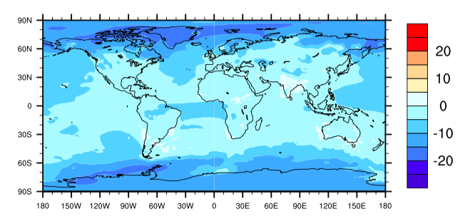
Analysis of BC Aging with CAMChem Model
Yinrui Li, Nicole Riemer, Laura Fierce, …?? Donald Wuebbles Department of Atmospheric Science, The School of Earth, Society & Environment , College of Liberal Arts and Sciences, University of Illinois at Urbana-Champaign
Introduction
Method
MAM4 and Aging Scheme in CAMChem
Condensation: “Monolayer-of-sulfate criterion
Timescales of BC aging based on PartMC-MOSAIC simulations (Fierce et al., BAMS 2016):
Results
Sensitivity Analysis on Number of Monolayers
2. Sensitivity Analysis on Number of Monolayers
3. Comparing BC Mixing State from CAMChem to SP2 Measurements. (March for example, 992hPa)
L1
L2
Condensation plays a dominating role.
Aging timescales range from less than one hour to several days.
MAM4 aging timescales are broadly consistent with PartMC MOSAIC aging timescales.
The ‘aging’ process of BC.
Conversion of fresh, hydrophobic black carbon into aged, hydrophilic black carbon.
Directly contributing to CCN activation and wet removal.
4-mode Modal Aerosol Model (MAM4) in CAMChem
Monthly BC Mass Mixing Ratio (L8, 992hPa)
L4
L8
Relative Difference (L1-L8)/L8, 992hPa
ng/kg
10⁰ 10¹ 10² 10³ 10⁴
BC Climate Effect.
BC strongly absorbs visible light, ranked as the 2nd largest anthropogenic warming agent (1.1 W/m²) after CO₂ (1.6 W/m²).
Large uncertainties (0.17 to 2.1 W/m²) exists in climate models.
Failure to capture aging is one key contribution to the uncertainties of BC burden and climate effect.
Aitken Accumulation Coarse
Coagulation
Condensation
%
BC Ratio in CAMChem
(BC in Accumulation Mode/Total BC)
10⁰ 10¹ 10² 10³ 10⁴
Monthly BC Vertical Profiles
Primary Carbon
BC aging timescale computed from model transfer rate due to Coagulation and Condensation processes (aging).
March
In the Arctic:
Most of BC is in primary carbon mode (externally mixed)!
Geometric standard deviations and dry diameter range. (Liu et al., 2012).
1
2
3
L1
BC Aging in Climate Models
BC particles are usually characterized with an arbitrary aging timescale (1-2 days) or with mechanistic transfer rates.
Aging rates are very sensitive to the choices of assumed parameters.
MAM4 | σ_{g} | Size range (μm)
Aitken | 1.6 | 0.015-0.053
Accumulation | 1.8 | 0.058-0.27
Primary carbon | 1.6 | 0.039-0.13
Coarse | 1.8 | 0.80-3.65
September
L8
%
1
2
3
BC Volume Fraction within SP2 Size Range (90 - 400nm)
Mixing State of BC Observed by SP2
The equivalent of 8-monolayers of sulfate is needed to transfer material from the primary carbon mode (fresh) into the accumulation mode (aged).
1
L1: 1 monolayer
L2: 2 monolayers
L4: 4 monolayers
L8: 8 monolayers
BC core
2
3
Primary Carbon Mode
Primary Carbon Mode
PartMC MOSAIC and CAMChem
CAMChem uses mechanistic aging rates, very sensitive to the choices of assumed parameters.
PartMC-MOSAIC estimates BC aging timescales more precisely by tracing the mass and composition of individual particles.
PartMC-MOSIAC parameterization of BC’s aging can be applied to the output of CAMChem model to assess the accuracy of its aging criterion.
monolayer depth = molecule diameter
8 monolayers of sulfate
Accumulation Mode
Accumulation Mode
CAMChem
PartMC
SP2 can capture most of BC in accumulation mode (internally mixed) when it is close to source regions.
Most of BC detected by SP2 measurements is externally mixed in Arctic region.
condensation coagulation
I_{cond}: total volume condensation rate over surface area.
N: total aerosol number concentration.
Reference

Slide 4
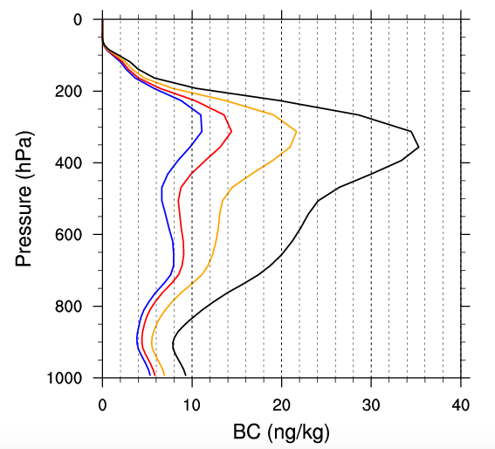
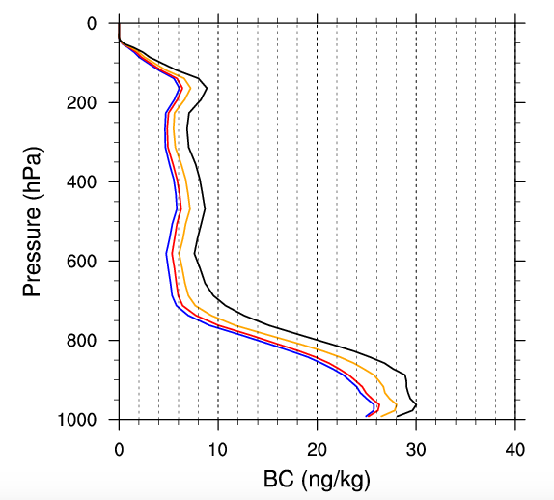
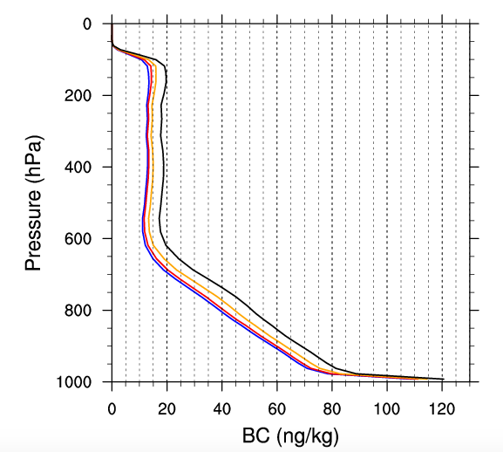
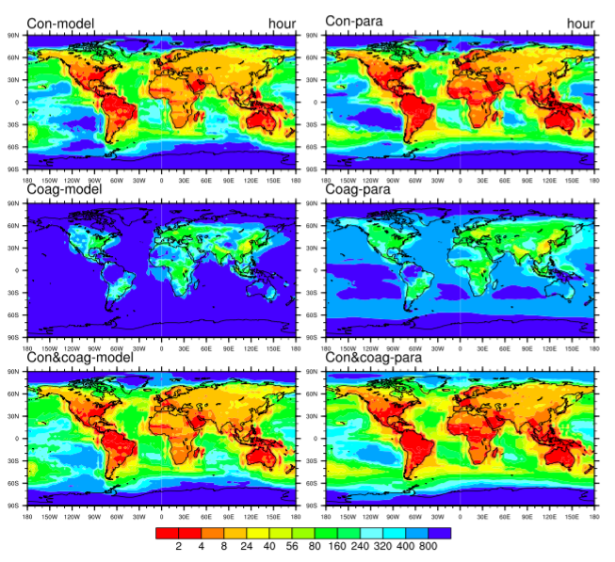
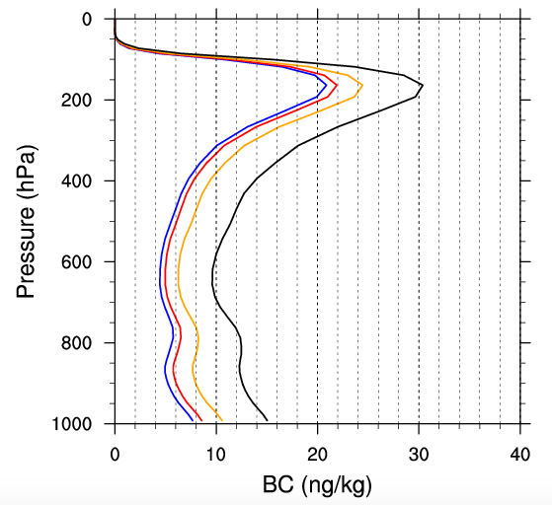
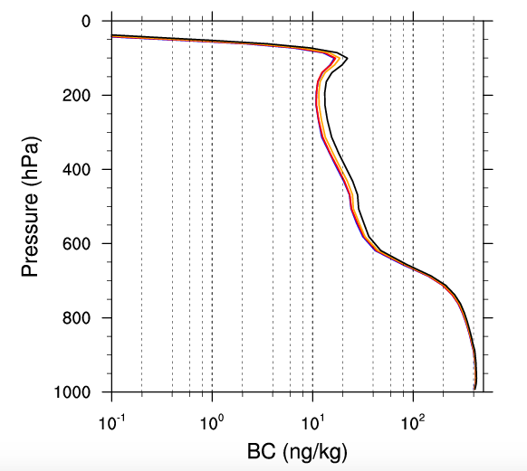
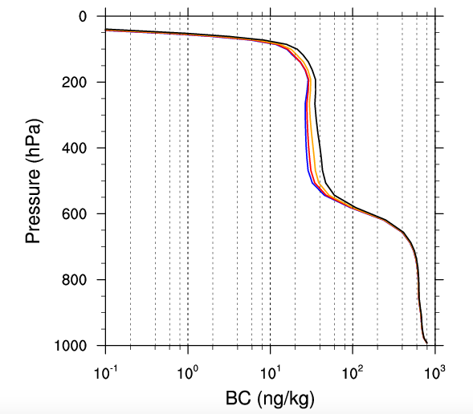
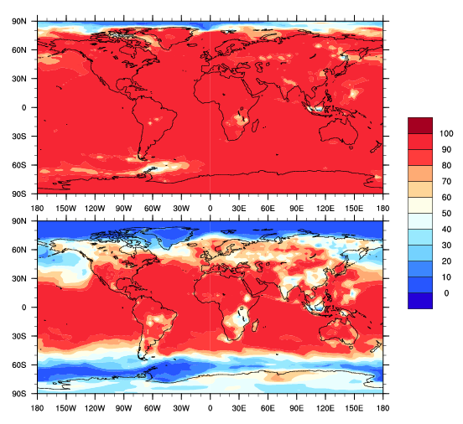
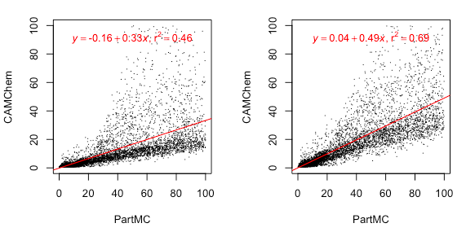
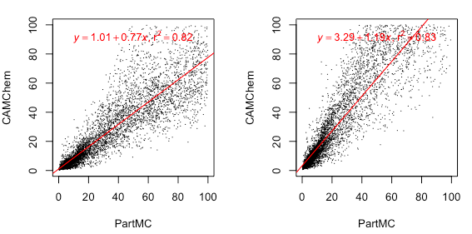
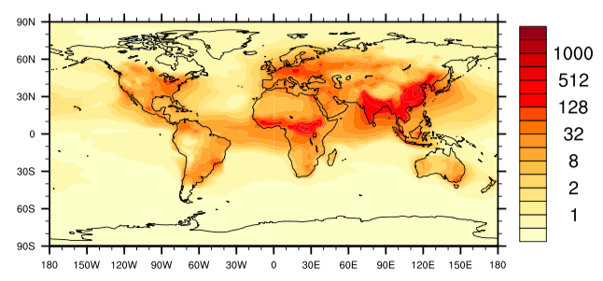
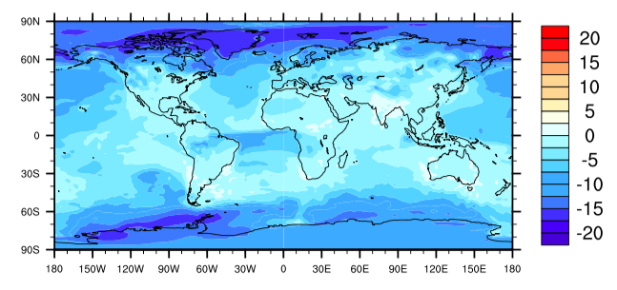
Sensitivity of Black Carbon Aging to Modeling Assumption in CAMChem
Yinrui Li¹, Nicole Riemer¹, Manvendra Krishna Dubey² , Allison C Aiken², Laura Fierce³, Donald Wuebbles¹
1. Department of Atmospheric Science, The School of Earth, Society & Environment , College of Liberal Arts and Sciences, University of Illinois at Urbana-Champaign
2. Earth and Environmental Sciences Division, Los Alamos National Laboratory， 3.Environmental and Climate Sciences Department, Brookhaven National Laboratory
Introduction
Method
Model Specifications
Modal Aerosol Model (MAM4) in CAMChem
Condensation: “Monolayer-of-sulfate criterion”
Results
1. BC Burden Sensitivity to Monolayer Criterion
2. BC Mixing State Sensitivity to Monolayer Criterion
3. BC Annual Direct Radiative Forcing – Arctic
4. Comparison of Annual Aging Timescales from CAMChem model and PartMC Parameterization
Scatter Plot of CAMChem and PartMC Aging Timescales
Monthly BC Vertical Profiles
Buseck and Posfai, 1999
March
CAMChem
PartMC
The ‘aging’ process of black carbon (BC)
Conversion of fresh, hydrophobic black carbon into aged, hydrophilic black carbon.
Directly contributing to CCN activation and wet removal.
Version: CESM1_2_2_CAMChem
Compset: MAM4 + interactive chemistry + offline meteorology
Time period: January 2010 – December 2010
1
2
4
8
1
2
3
September
BC Climate Effect
BC strongly absorbs visible light, ranked as the 2nd largest anthropogenic warming agent (1.1 W/m²) after CO₂ (1.6 W/m²). [1]
Large uncertainties (0.17 to 2.1 W/m²) exist in climate models. [1]
Limited understanding of aging is one key contribution to the uncertainties of estimating BC burden and climate effect.
1
2
3
10⁰ 10¹ 10² 10³ 10⁴
Aitken Accumulation Coarse
1
1 monolayer
2 monolayers
4 monolayers
8 monolayers
Coagulation
Condensation
2
3
hour
10⁰ 10¹ 10² 10³ 10⁴
Primary Carbon
Aging Process
condensation coagulation
BC Ratio in CAMChem (BC in Accumulation Mode/Total BC)
I_{cond}: total volume condensation rate over surface area. [2]
N: total aerosol number concentration. [2]
The equivalent of 8-monolayers of sulfate is needed to transfer material from the primary carbon mode (fresh) into the accumulation mode (aged).
March (992hPa) September (992hPa)
BC aging timescale computed from model transfer rate due to coagulation and condensation.
Goal: Aging in CAMChem and PartMC MOSAIC
CAMChem uses mechanistic aging rates, very sensitive to the choices of assumed parameters. [3]
Particle resolved model (PartMC-MOSAIC) estimates BC aging timescales more precisely by tracing the mass and composition of individual particles. [4]
PartMC-MOSIAC parameterization of BC’s aging can be applied to the output of CAMChem model to assess the accuracy of its aging criterion. [2]
BC core
L1
L1
L1
L2
8 monolayers of sulfate
monolayer depth = molecule diameter
%
L8
L8
L4
L8
Annual BC Mass Mixing Ratio (992hPa)
In the Arctic:
Most of BC is in primary carbon mode (externally mixed)!
L8 (default)
Conclusions
Simulated BC burden is most sensitive to the choices of aging criterion in the high-latitude regions, with maximum differences in the annually averaged BC mixing ratio of 16% near the surface.
Aging timescales range from less than one hour to several days.
Condensation of SOA and sulfate plays a dominating role in BC aging, compared to coagulation.
MAM4 aging timescales are broadly consistent with PartMC-MOSAIC aging timescales.
ng/kg
1 monolayer (992hPa) 8 monolayers (992hPa)
When using an 8-monolayer sulfate criterion, the aging timescales have the closest linear-regression slope to 1 and the highest R² value among four sensitivity cases.
Relative Difference (992hPa)
(L1– L8) / L8
These two plots still need to be updated (now for March).
References
Bond T., et al. J. Geophys. Res. Atmos., 118, 5380–5552, 2013.
Fierce, L, et al. Bull. Amer. Meteor. Soc. doi:10.1175/BAMS-D-16-0028.1, in press.
Liu, X., et al. Geosci. Model Dev., 5, 709–739, 2012.
Riemer, N et al. J. Aerosol Sci., 41(1):143–158, 2010.
Acknowledgement: This Work is funded by the Department of Energy, Los Alamos National Lab.
Relative differences are highest at high latitudes (distant from the sources).
%
L1: 1 monolayer; L8: 8 monolayers
W/m²
W/m²

